Slide 1
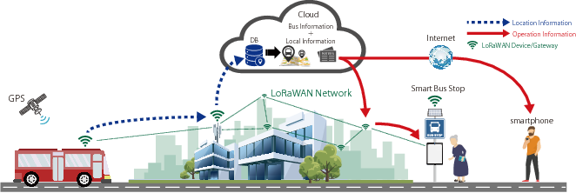
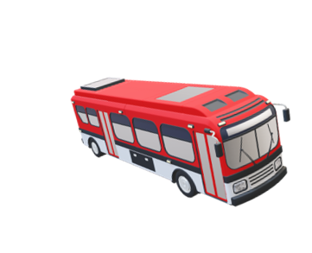
Smart communication in transportation Case study: Smart Bus System
Group 1
Abhinav Damle (ASD)
Elahe Nasiri (DS)
Elham Honarvar (MSD)
Gijs Walravens (ST)
Tesfay G. Chekole (ST)

Slide 2
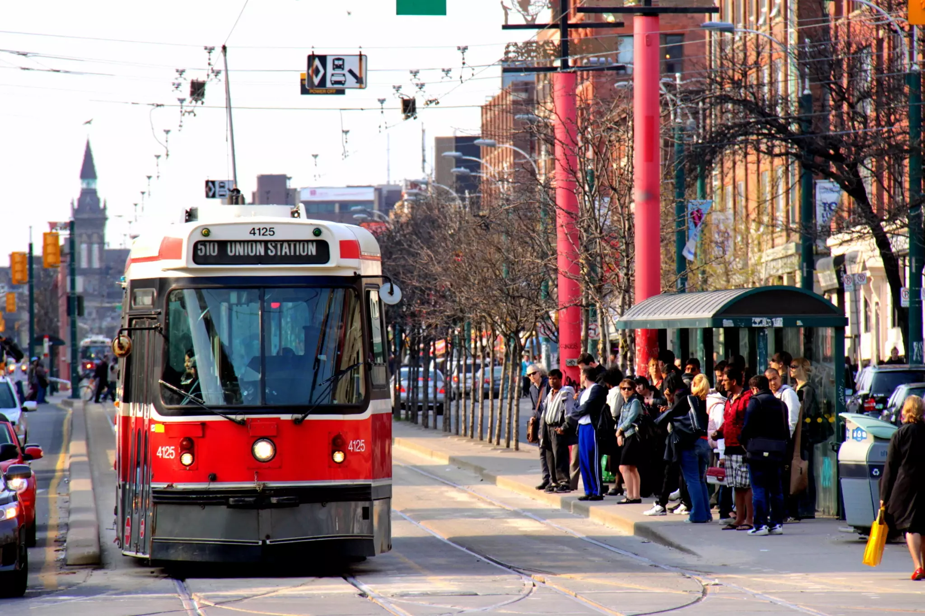
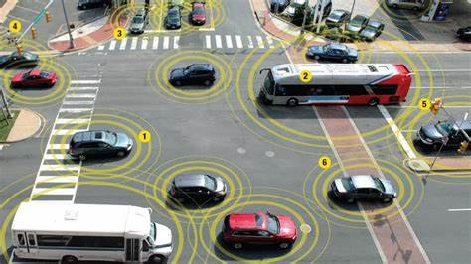
Problem definition
Current transportation issues:
Traffic management issues
Lack of communication between different organization
Passengers' dissatisfaction
Parking issues
Lots of delays and cancellation
Increase in the number of accidents
What we plan for in our designed system:
Traffic control
Safer transportation
Dealing with emergency issues
Smart scheduling prevents delays
Improved transportation infrastructure
Passenger satisfaction with the use of a smart announcement system
A better exchange of information between private and public transportation
Collision prevention

Slide 3
Nine boxes
Super system | Driver Unions Bus transport company Maintenance company Bus storage Passenger Insurance company Regulation agency Legal authorities | Driver Unions Bus transport company Maintenance company Bus storage Passenger Insurance company Regulation agency Legal authorities | Driver Unions Bus transport company Maintenance company Bus storage Passenger Insurance company Regulation agency AI research institutions Legal authorities
System | Mostly combustion driven propulsion Driver operated heating Driver operated lighting Static information provision Static schedule Navigation Cash and card payment/check-in Little to no bus tracking Manual opening and closing doors Manual parking | Combustion, electric, and hybrid propulsion Driver operated heating Driver operated lighting Periodically updated information provision Periodically updated schedule Navigation with traffic abnormalities Cash and card payment/check-in Periodic bus tracking Semi-automated door lock and unlock Semi-automated parking | Combustion, electric, hybrid, and early hydrogen propulsion Smart, self-adjusting heating Smart lighting based on environment Live updated information provision AI assisted/self-driving Collision prevention Smart scheduler Navigation with live traffic information Connectivity Automated digital payment/check-in Communication among buses Live bus tracking Automated parking Automatic fining system
Sub System | Combustion engine Heater Lamps Display Cash register and card scanner Navigation system | Combustion engine, electric engine, hybrid engine Heater & air conditioning Lamps Display Cash register and card scanner Navigation system with periodic traffic updates Sensors at bus stops | Combustion engine, electric engine, hybrid engine, hydrogen engine Smart heater & air conditioning Smart lamps Display Card detector, payment via face ID Navigation with live traffic updates Live data stream from sensors in busses
 | Past | Present | Future

Slide 4
Mission
"Proving safe and efficient public transport for all"
Pre-mission | Mission | Post-mission
Potential passenger looks for bus to board Potential bus is following route | If a free bus is available, it is rerouted to passenger's route to mitigate delay If no free bus available, inform the potential passenger of the delay suggest and alternative faster route if available Communicate with different buses in the route If passengers forget to check-in inform them using the designed mobile app Get UpToDate information regarding traffic, weather or an emergency case for better organization of the route | Passenger arrives at destination with minimal or no delay in schedule Rerouted buses are reevaluated after arrival to potentially rebalance schedule again

Slide 5
Use case
Driver:
Check the smart schedule and use GPS in order to choose the best route.
Get alert through anti-collision system
Inform other buses and maintenance center in case of emergency situation(accident on the road, maintenance of the bus, malfunction of system)
If the bus is full (passenger counting system) , inform passengers and other buses through smart announcement system and smart scheduler and ask for backup bus.
Passenger:
The user check the schedule of the bus from the app or smart announcement system in bus stop
Buy ticket via app or using smart payment system
Using on-board Wi-Fi in the bus
Get the updated information about schedules of other buses, weather or any accident
Receive a notification on the user's mobile app in the event that user neglect to check in
Check-out at the destination to end the journey

Slide 6
Project context
Limitations:
There are some limitations regarding data privacy
Vulnerable to Cyber attack
Budget limitation
Managing Big Data is difficult
Lack of organizational cooperation
The system should pass several standard tests
Old generations are not comfortable with this current system
Assumptions:
Users are familiar with the current system
Current system are compatible with the old one
Different organization cooperating in this designed system (hospital, traffic control center, police, passengers)
Data availability
In the event of a problem or emergency, there are some experts for the current system.

Slide 7
Domains
Mobility
Electrical
Mechanical
Regulatory
IT
Ethical
Environmental
Health
Bus storage
Insurance
Manufacturing
Business
Safety
AI
Security
Traffic
Computer vision
Automative

Slide 8
Domains – Mobility Domains - AI
+ Speed
+ Power
+ Shape
+ Volume of moving/stationary object
+ Adaptability or versatility
- Weight of moving/stationary object
- Use of energy by moving/stationary object
+ Speed
+ Adaptability or versatility
+ Reliability
+ Measurement accuracy
+ Difficulty of detecting and measuring
- Ease of repair
- Use of energy by moving/stationary object
- Device complexity

Slide 9
Stakeholder needs
Real needs | Perceived needs | Expressed needs
Increase income of the company
Save time | Reduce the commuting time Have an accurate schedule | Using dynamic routing, busses can avoid traffic congestion, which leads to spending less time commuting Using previous data about the expected number of passengers at each stop, should give an accurate estimation of arrival and departure time
Save money | Increasing efficiency leads to needing less staff | By saving time in the commuting step, we can employ less number of drivers
Access to real-time information about the current state of the system | Real-time updates about the current location and ETA Frequent updates about the functionality of the bus and bus stops, e.g. needing to be fixed or replaced | Implement a dashboard for summarizing a variety of information, including geographical, functional, etc. about different parts of the system
Promote the image of the company
Safety | Reducing the number of accidents Insurance | Implement smart driving assistant in the bus to reduce the effect of human errors Find the right insurance plan to cover all the potential risks
Comfort | Air conditioning Comfortable seats Enough number of empty seats based on the expected number of passengers | Keep the temperature of the bus and stations in a standard level Improve the quality of seats by changing the designs into the ergonomically shaped seat Use previous data to predict the number of passengers at each time slot and dedicate enough busses and seats
Save energy | Replacing the fossil fuel with clean energy sources | Implementing solar panels to use solar energy Use hydrogen fuel
User-friendly | Working with system should be easy for everyone from different age-groups and supports different languages | Implementing an easy-to-use GUI Place adequate information screens at bus stops and in buses

Slide 10
Requirements - Efficiency
*MoSCoW method
Requirement | Priority*
The smart bus shall have a battery capacity of at least 400 kWh (to be compatible with our designed system) | M
The smart bus shall have a battery capacity of at least 600 kWh | S
The smart bus shall have a battery capacity of at least 700 kWh | C
The smart bus shall can reach at least 100 kph (to be compatible with our designed system) | M
The smart bus shall can reach at least 120 kph | S
The smart bus shall can reach at least 130 kph | C
The smart bus shall have 60 seats (to be compatible with our designed system) | M
The smart bus shall have 90 seats | S
The smart bus shall have 120 seats | C

Slide 11
Requirements - Interoperability
Requirement | Priority
The smart scheduler shall be fully compatible with the old schedule | M
The smart bus system will be able to classify all vehicle classes build after 1970 | M
Requirements - Scalability
Requirement | Priority
The smart bus system shall be able to communicate with at least 100 other smart buses and other vehicles | M
The smart bus shall be able to communicate with at least 200 other smart buses | S
The smart bus shall be able to communicate with at least 300 other smart buses | C

Slide 12
Requirements - Safety
Requirement | Priority
The bus collision prevention system shall stop no closer than 1 m away from the obstacle | M
Requirements - Usability
Requirement | Priority
The new smart scheduler can add buses to routes if delays are at least 5 minutes | M
The new smart scheduler can remove busses from routes buses arrive at least 5 minutes early | M
The smart bus check-in system shall check the user in within 4s | M
The smart bus check-in system shall check the user in within 2s | S
The smart bus doors shall open within 3s | M

Slide 13
Requirements - Reliability
Requirement | Priority
The smart scheduler shall be updated at most every 30s | M
The smart scheduler shall be updated at most every 15s | S
The smart scheduler shall be accurate to at most three minute difference | M
The smart scheduler shall be accurate to at most two minute difference | S
The smart scheduler shall be accurate to at most one minute difference | C
The smart bus check in system shall catch 90% of all defaulters | M
The smart bus check in system shall catch 95% of all defaulters | S

Slide 14
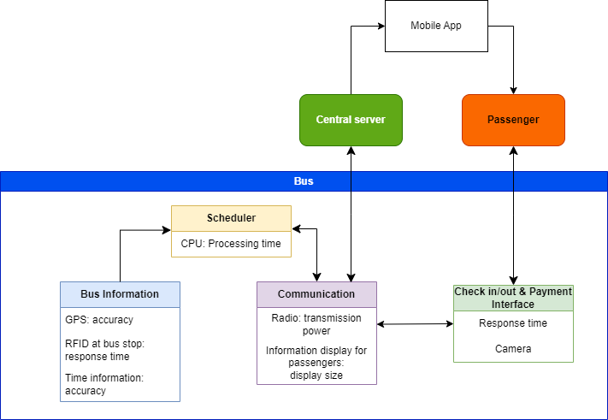


Logical architecture
External factors interacting with our designed system
User

Slide 15
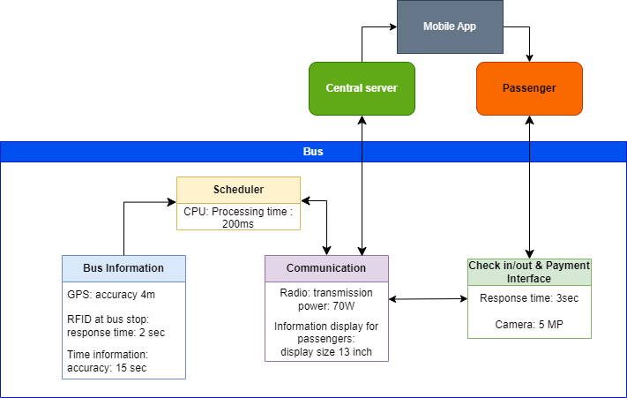


Different cases for physical architecture
Case 2
Case 3
Case 1

Slide 16
Trade-offs
Performance
Performance
Case 1
Case 1
Case 2
Case 2
Case 3
100W
1M
70W
300K
70W
Case 3
500K
Time(ms)
Cost(Euro)

Slide 17
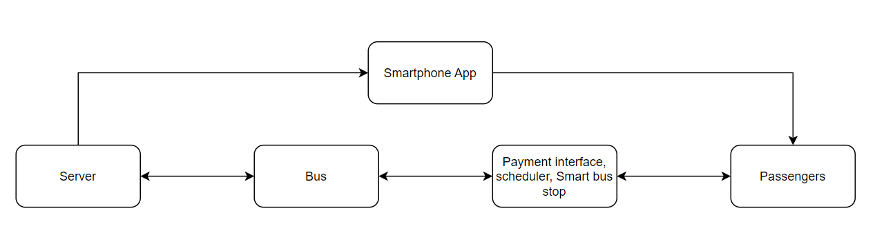
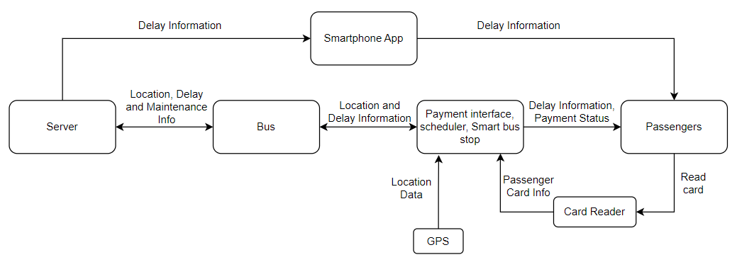
Information Interfaces
Abstract:
Solution:

Slide 18
Information flow
External information flow
Quality Of Service constraints
Bus location data to track bus location in real-time and provide information to passengers.
Passenger information to monitor passenger count, payment transactions, and route preferences.
Traffic information to adjust routes and improve travel time.
Weather information to adjust schedules and ensure safe operation.
Maintenance data to monitor bus performance and schedule maintenance.
Customer feedback to improve the overall transportation system.
Integration with public transportation systems to provide good way of connectivity.
Reliability: A minimum level of reliability must be maintained for the interfaces that transmit critical data, such as real-time bus location data, to ensure that the data is transmitted accurately and without errors.
Availability: The interfaces must be available 24/7 to ensure that critical data, such as passenger information and traffic data, can be transmitted and processed in real-time.
Latency: The interfaces must have low latency to ensure that real-time data, such as bus location data, is transmitted quickly and accurately.
Bandwidth: The interfaces must have sufficient bandwidth to support the transmission of large amounts of data, such as real-time video feeds from onboard cameras.
Security: The interfaces must be secure to prevent unauthorized access to sensitive data, such as passenger information and payment transactions.

Slide 19
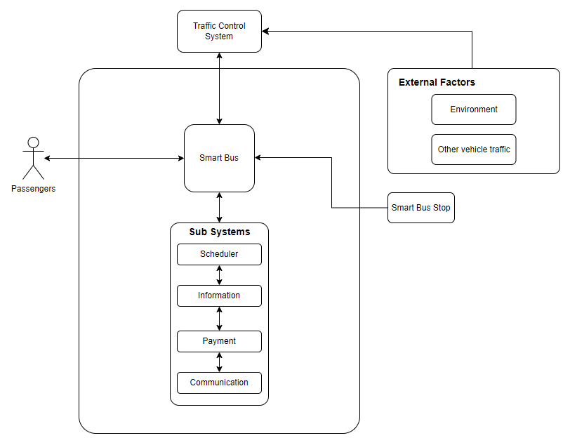
Logical flow

Slide 20
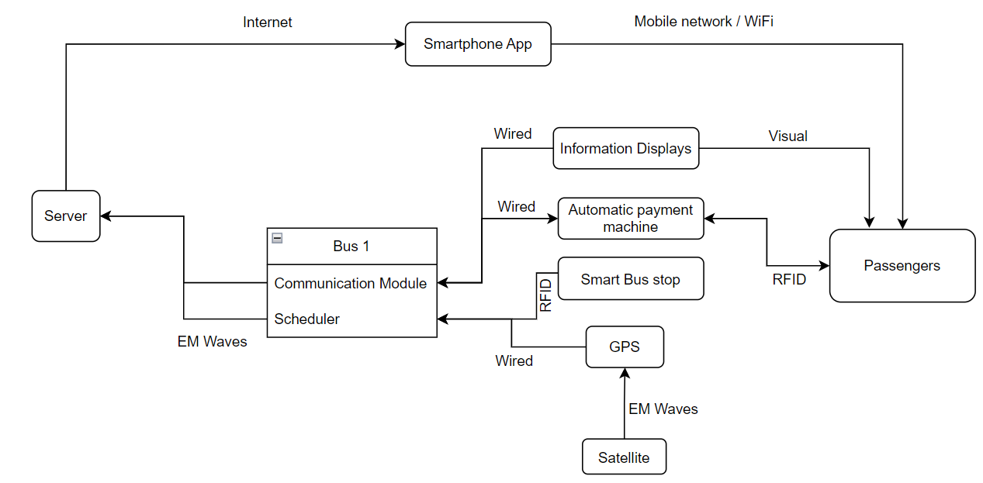
Interface(s) at physical level
Logical:
Physical:

Slide 21
Verification & Validation
Description
Mission 1 | Time management
Mission 2 | Safety
Mission 3 | Smart communication
Mission 4 | Cost management
Mission 5 | Security
Mission 6 | Environmental consideration
Mission 7 | Comfort
Requirements
RQ 1 | Efficiency
RQ 2 | Interoperability
RQ 3 | Scalability
RQ 4 | Safety
RQ 5 | Usability
RQ 6 | Reliability
Validation
Val 1 | Real-world performance with at least 20 buses, other vehicles, corresponding organizations and some volunteer passengers in a random route
Val 2 | Phase 1: Real-world performance with few buses, vehicles and volunteer passengers Phase 2: Reduction in number of accidents(statistical analysis provided by different organizations)
Val 3 | Phase 1: The performance of smart schedular and check for any unforeseen changes in schedule or delay. Satisfaction of users and receiving feedback from different organizations(traffic control center, other vehicles). Compare the data provided by different sensors and calculate the error Phase 2: Reduction in number of accidents(statistical analysis provided by different organizations)
Val 4 | Statistical data regarding reduction in human resource(police, security check and …)
Val 5 | Simulate a cyber attack to check the robustness of the whole system and communication
Val 6 | Check the statistical data for any reduction in energy consumption Drop in air pollution
Val 7 | Satisfaction of the users Any possible decrease in the number of private vehicles
Verification
Ver 1 | Test the range capacity of the effective communication
Ver 2 | Test the compatibility of new scheduler with the old system
Ver 3 | Test the scalability of communication for at least 200 vehicles
Ver 4 | Reduction in number of accidents(statistical analysis and reports)
Ver 5 | Satisfactions of the users Check whether the scheduler reroutes buses in case of delay or possible changes in schedule Test check-in / check-out operation time (within 4s)
Ver 6 | Check the accuracy of data Check the accuracy of schedular in managing delays Check the performance of smart announcement system Check the number of detected defaulters

Slide 22
Verification & Validation
 | Ver 1 | Ver 2 | Ver 3 | Ver 4 | Ver 5 | Ver 6 | Val 1 | Val 2 | Val 3 | Val 4 | Val 5 | Val 6 | Val 7 | Coverage
RQ1 | X |  |  |  |  |  | X |  |  |  |  |  |  | H
RQ2 |  | X |  |  |  |  |  |  |  |  |  |  |  | H
RQ3 |  |  | X |  |  |  |  |  |  |  |  |  |  | H
RQ4 |  |  |  | X |  |  |  | X |  |  |  |  |  | M
RQ5 |  |  |  |  | X |  |  |  |  |  |  |  |  | H
RQ6 |  |  |  |  |  | X |  |  |  |  |  |  |  | H
M1 |  |  |  |  |  |  | X |  |  |  |  |  |  | H
M2 |  |  |  |  |  |  |  | X |  |  |  |  |  | H
M3 |  |  |  |  | X |  |  |  | X |  |  |  |  | H
M4 |  |  |  |  |  |  |  |  |  | X |  |  |  | M
M5 |  |  |  |  |  | X |  |  |  |  | X |  |  | H
M6 |  |  |  |  |  |  |  |  |  |  |  | X |  | M
M7 |  |  |  |  | X |  |  |  |  |  |  |  | X | L
cost | 1M | 2M | 10M | 500K | 1M | 2M | 10M | 10M | 5M | 10K | 500K | 10K | 20K

Slide 23
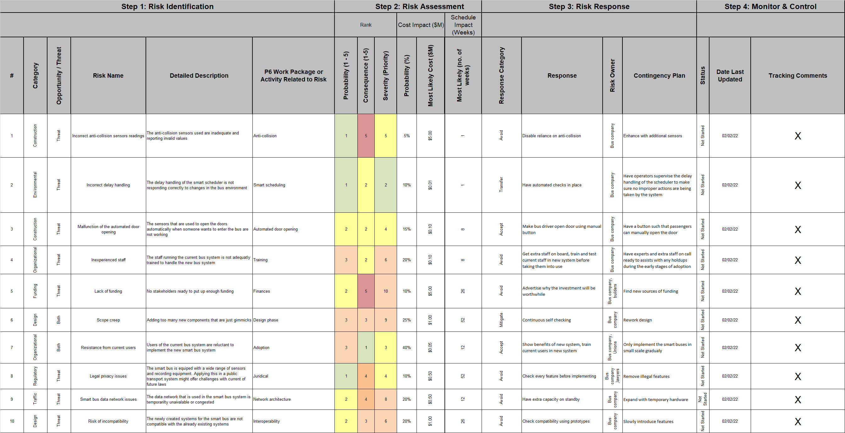
Risk Management

Slide 24
Work Package Management
Main Tasks:
Needs and Requirements analysis of smart transportation in general
Specify the Physical and Logical architecture for our case study (smart bus system)
Verification and Validation of our designed system
DSM matrix which demonstrates the relationship between different components of our system and different organization.
Risk management
Main modules to be developed for the designed system:
Bus scheduling system
Ticketing and payment system
Passenger information system
Anti-collision system
Communication between different vehicles and also different organizations.
The main goal:
The goal of the smart bus transportation system is:
To improve the efficiency, reliability, and convenience of public transportation by providing real-time information to passengers and dispatchers
Optimizing routes and schedules
Increase the user satisfaction
Streamline communication between businesses, private vehicles, and public transportation and also the user of our system

Slide 25
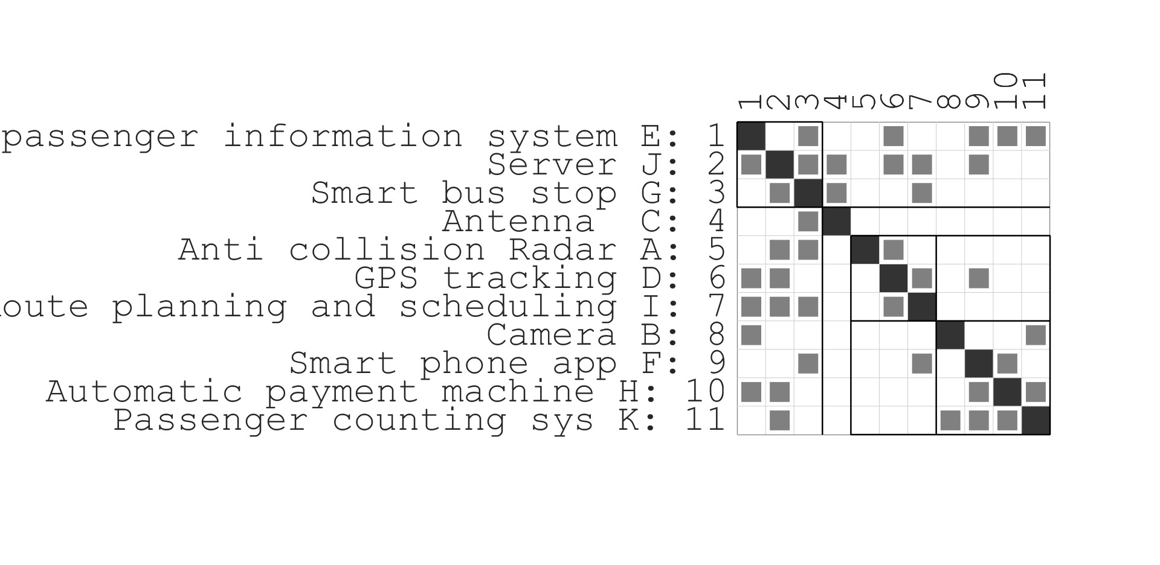
DSM - Functional:

Slide 26
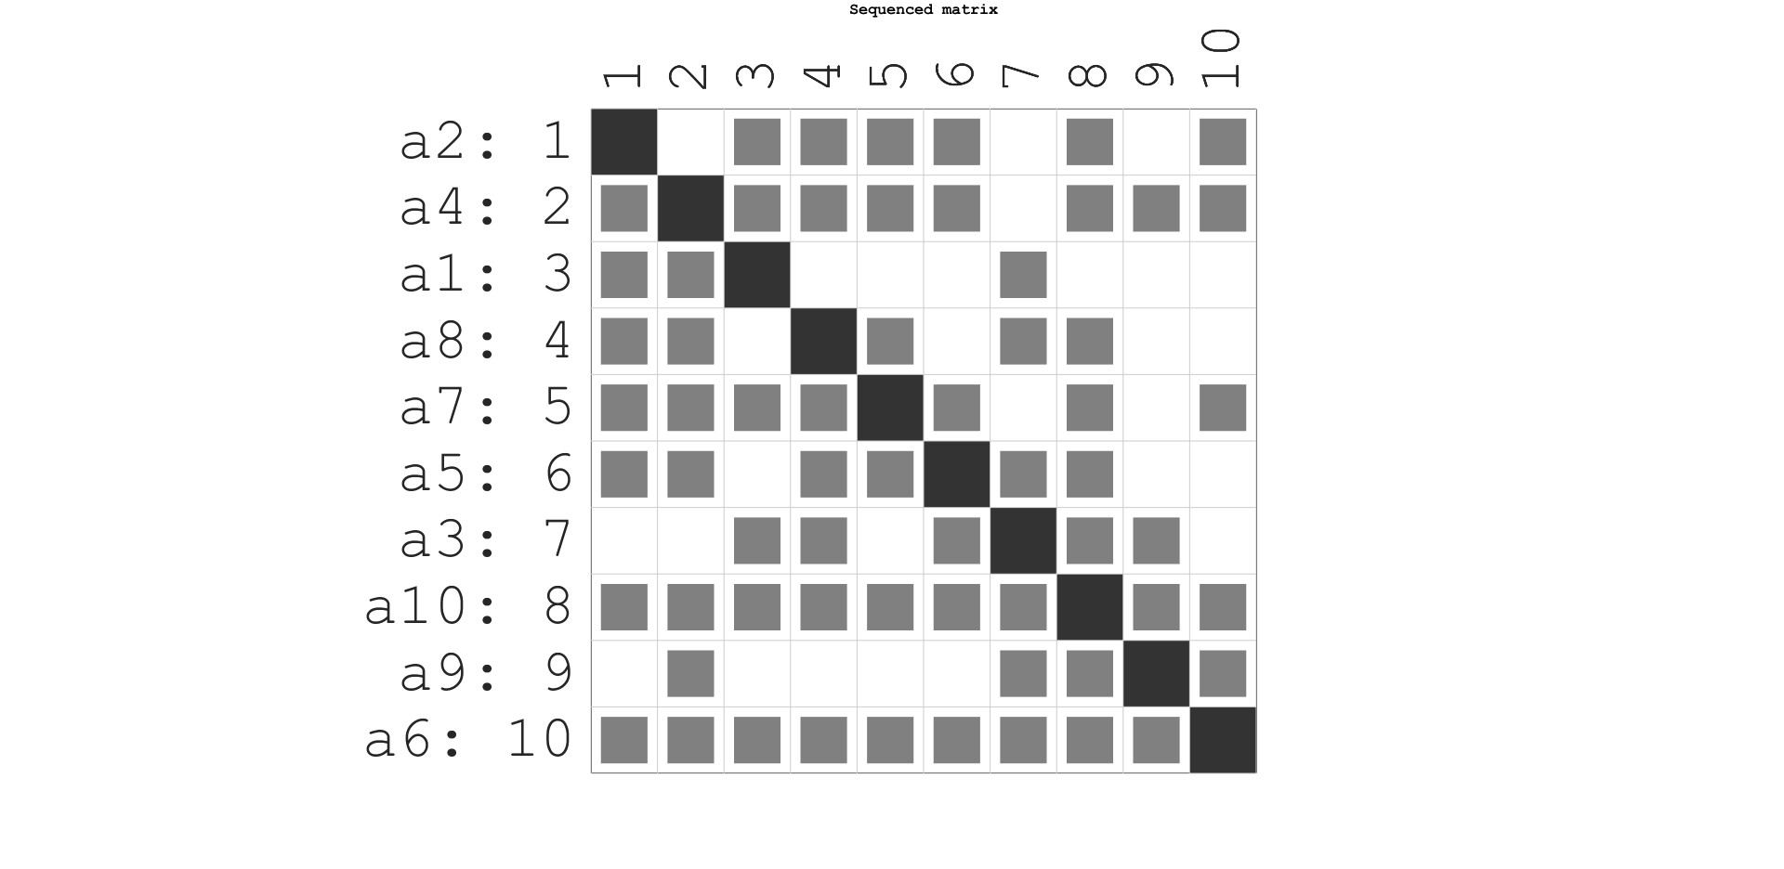
DSM - Activities:
a1: Stakeholder contact
a2: Creating and maintaining the smart scheduler
a3: Creating and maintaining the anti-collision system
a4: Creating and maintaining the passenger counting system
a5: Designing the software architecture
a6: Creating and maintaining the server infrastructure
a7: Upgrading bus stops to smart bus stops
a8: Verifying the smart bus system
a9: Checking legal regulations
a10: Building the smart buses

Slide 27
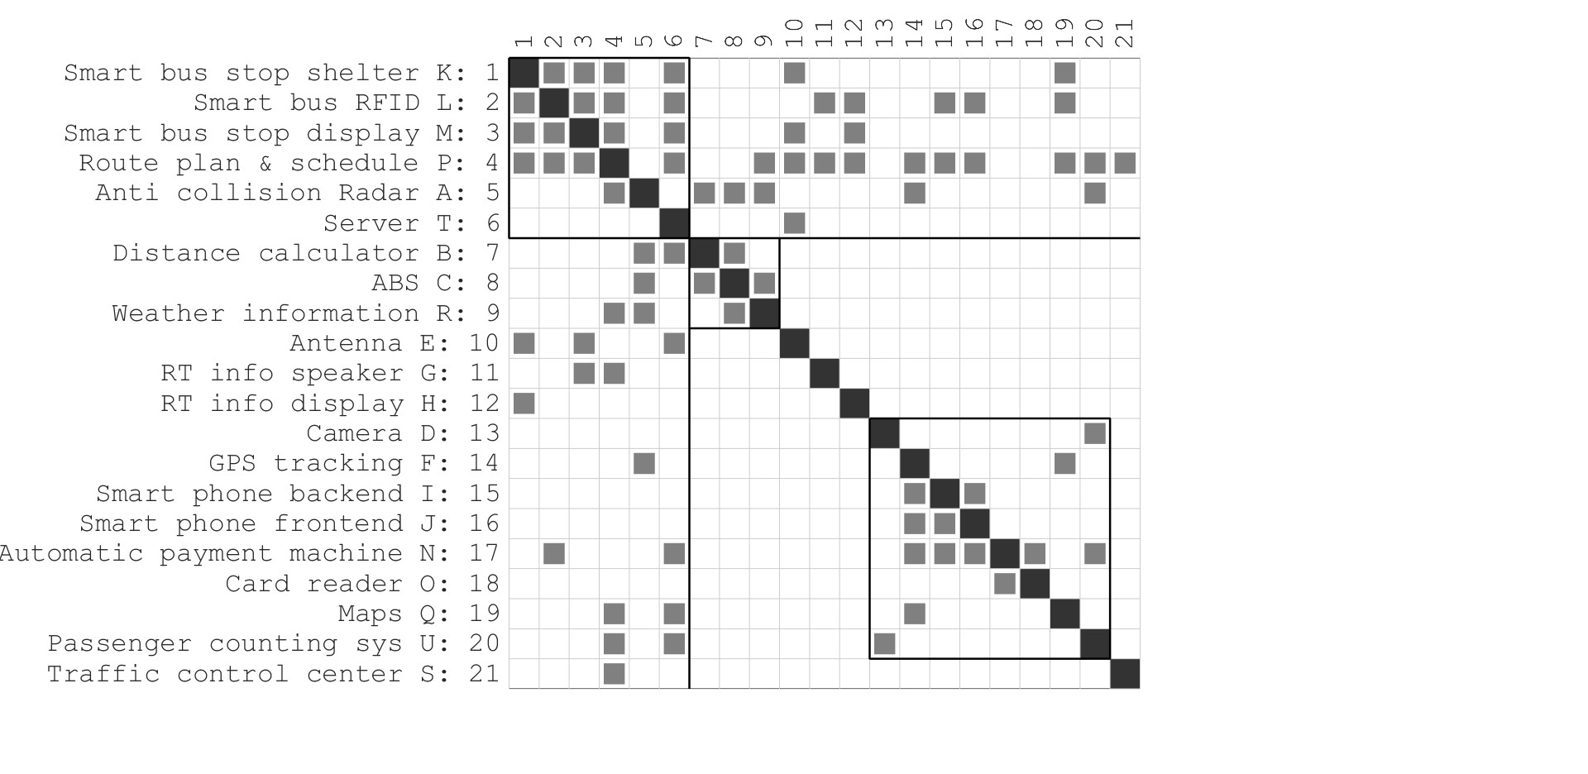
DSM - Organizational:

Slide 28
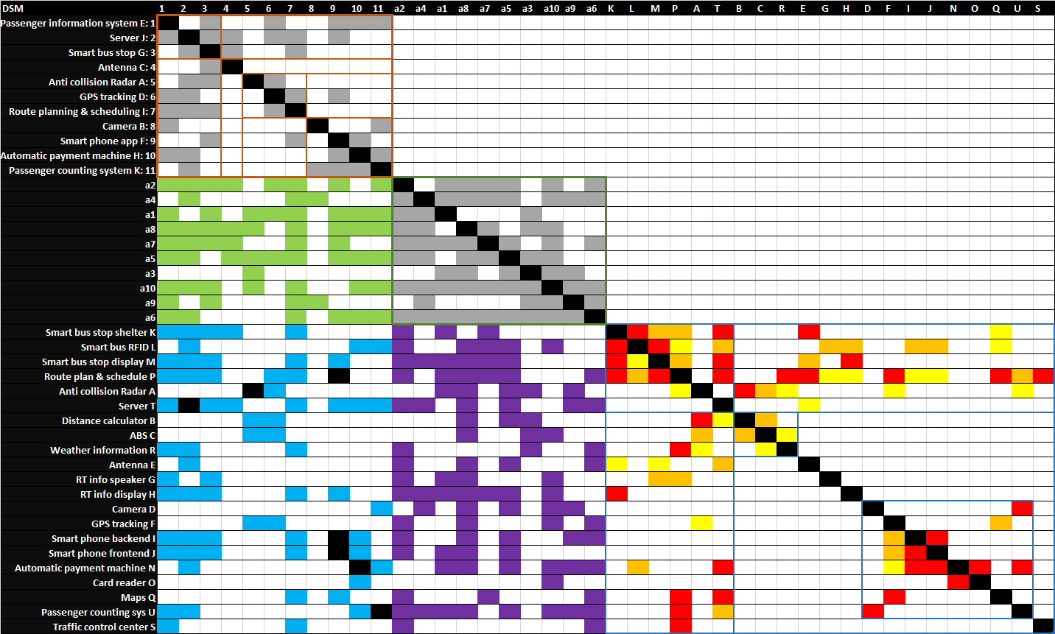

Slide 29

Thank you!

